Slide 1




PROJECT
Mentisano
Self Care is how you take your power back!

Slide 2
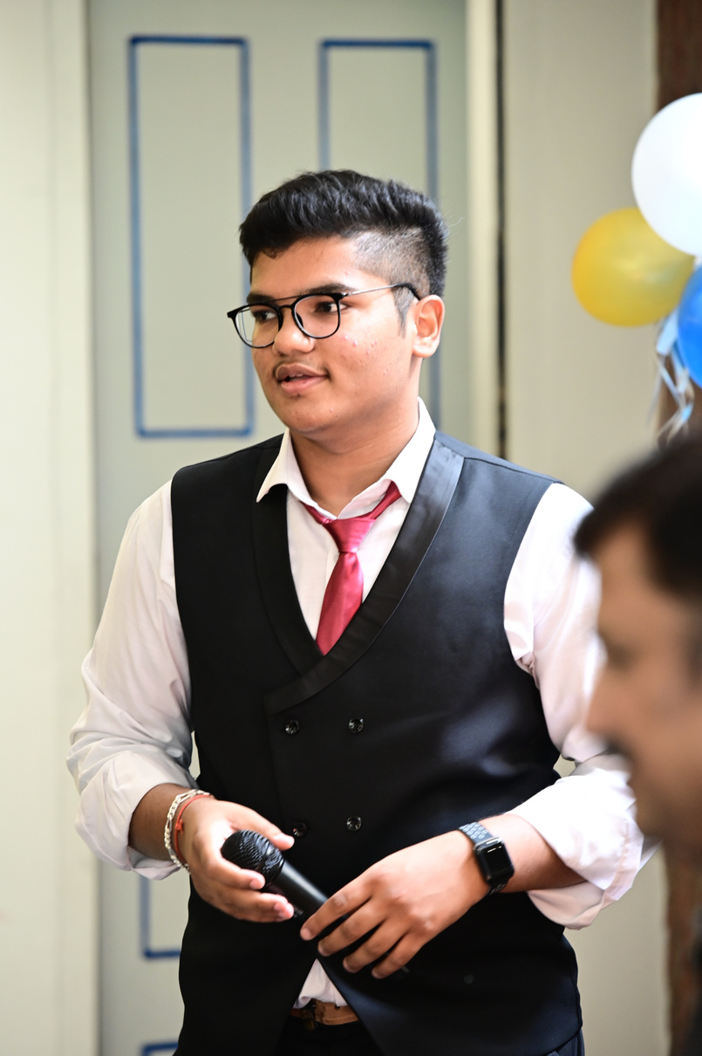
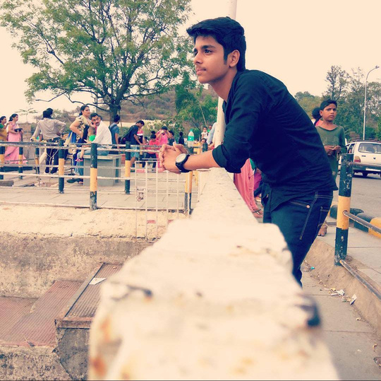
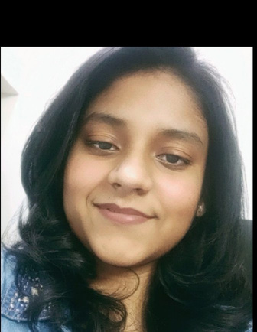
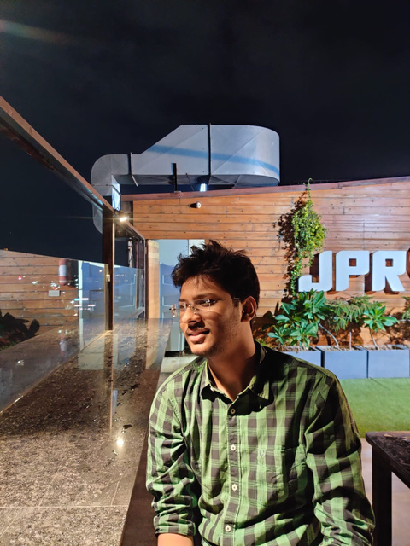
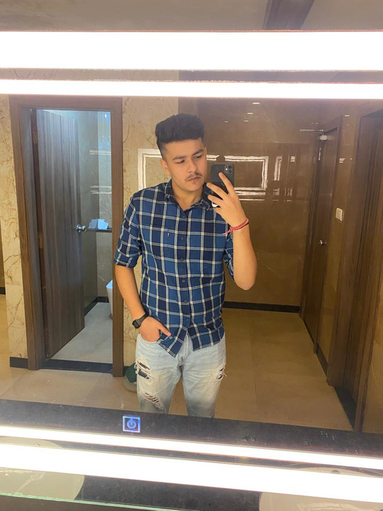
Team Mentisano
AADI JAIN
CHIRAG AGGARWAL
VIDHI SAXENA
RUDRANSH SRIVASTAVA
VISHV SINGH
Project Manager
App Development
App Development
Creative and Content
Design
EB15 (Team No. 75)

Slide 3

Have you felt any of these?
Eating or sleeping too little or too much
Having low energy
Feeling unusually confused, on edge, or scared
Hearing voices or believing things that are untrue
Inability to perform daily tasks

Slide 4
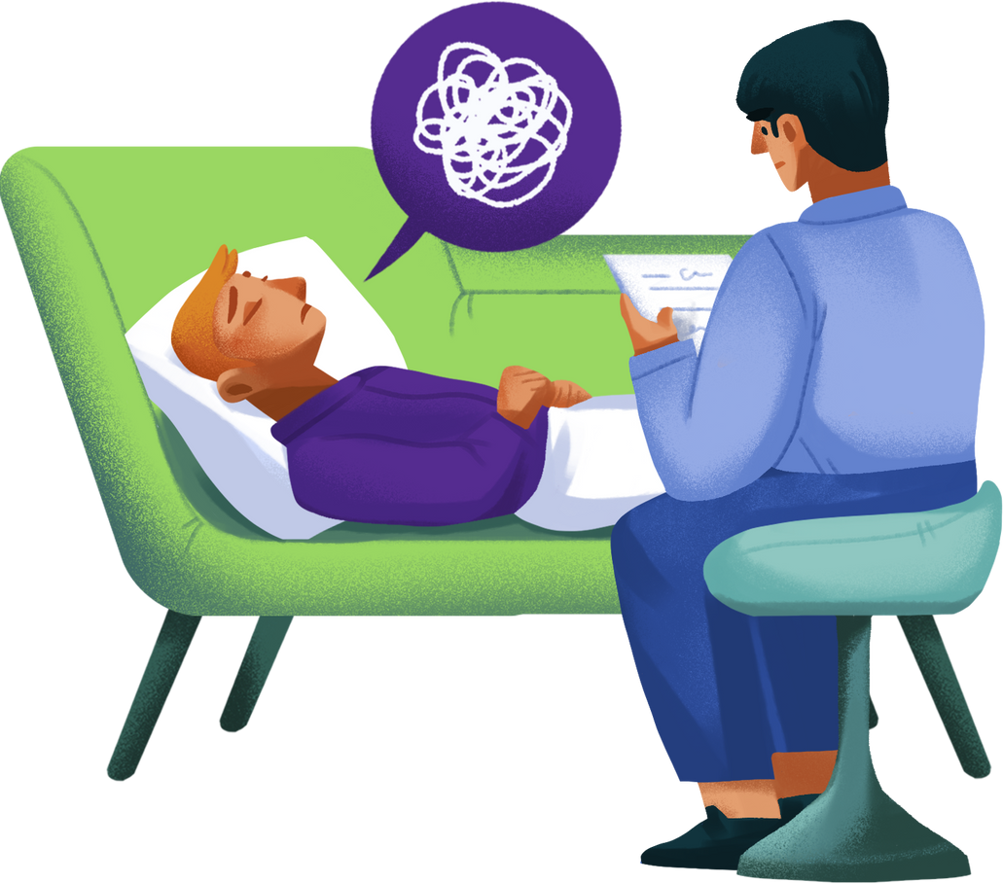
What is
Mental Health?
Is it a state of mind?

Slide 5

Defining Mental Health
Mental health is a positive concept.
It encompasses our emotions, our psyche, and our social interactions.

Slide 6

Looking for your Mental Health
We got your back

Slide 7

Mentisano
Agenda
To teach you mental health?
BIG NOOOO!
Do you want to relax and be calm?
Do you want to make yourself fit and healthy?
Felling bored, play some games?
Do you want to consult a therapist?
Want to spend time with someone who understands you?

Slide 8
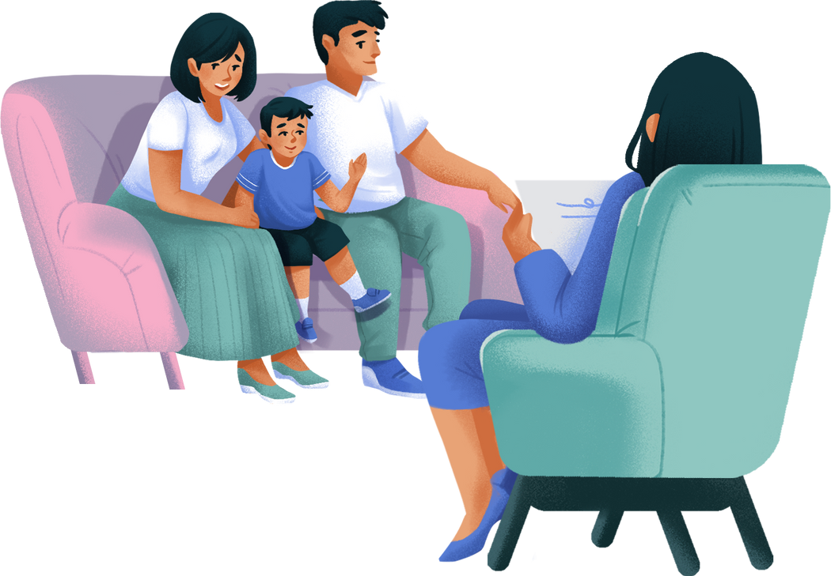
More Common than You Think
1 in 5 adults experienced a mental health concern in the past year.
Let's reduce that ratio!

Slide 9

How Do I Maintain Positive Mental Health?

Slide 10

A recent study has found that
people who exercise report
43.2%
less days of poor mental health than those who didn't exercise.
With Mentisano, we brings you Breathing Exercises Routine and Relaxing Atmosphere through videos.

Slide 11
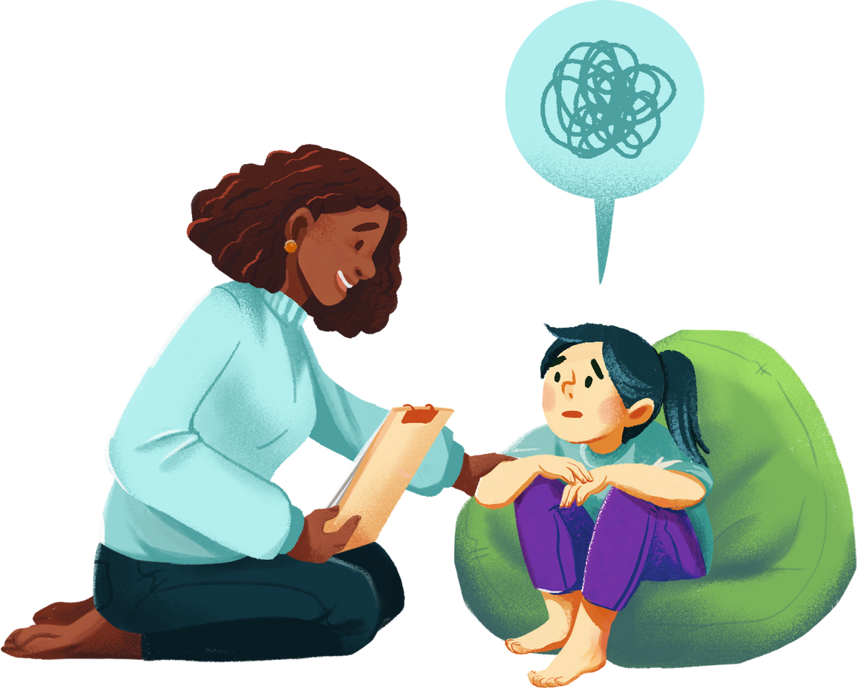
We help individuals like you to care for their holistic well-being.
Mentisano takes care for you even at your loneliest, so here are some fun and engaging games to make you feel excited and feel better!

Slide 12
Holistic Healing
50
Treatments for mental health problems vary.
40
30
20
It can include a mix of therapy, medication, and a support system.
10
0
Mentisano have it all.
Inpatient Treatment
Alternative Care
Support Group
Prescription Medication
Counselling/Therapy

Slide 13

When do I seek professional help?
You know it's time when you're comfortable seeking one.
Book a therapist from Mentisano!

Slide 14
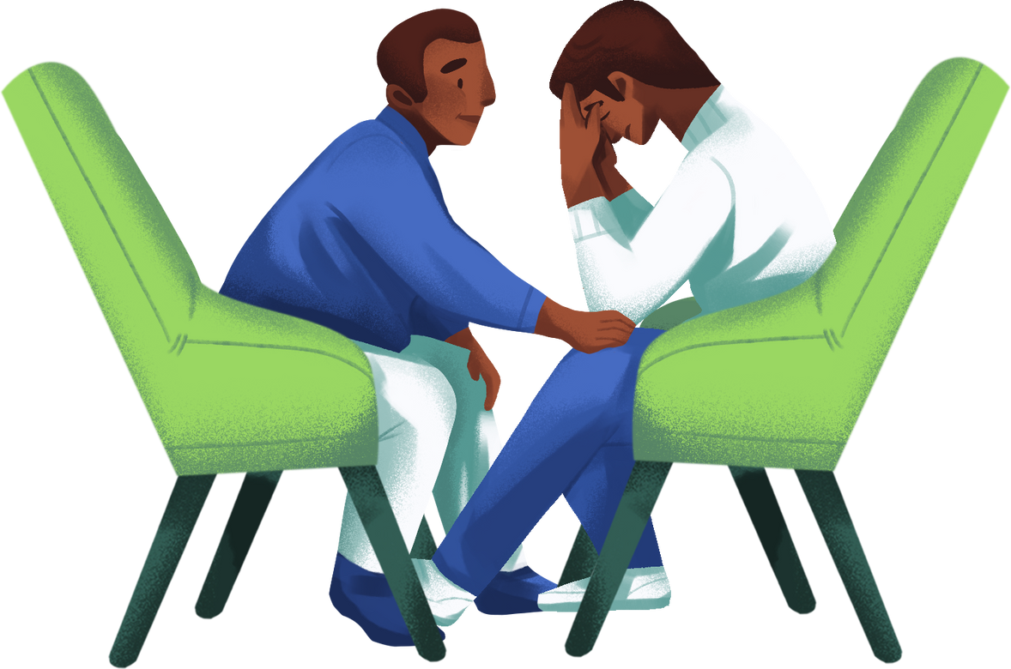
Don't hesitate to seek professional help.
We care about our hearts, so why can't we care for our minds?
Book a Therapist.

Slide 15
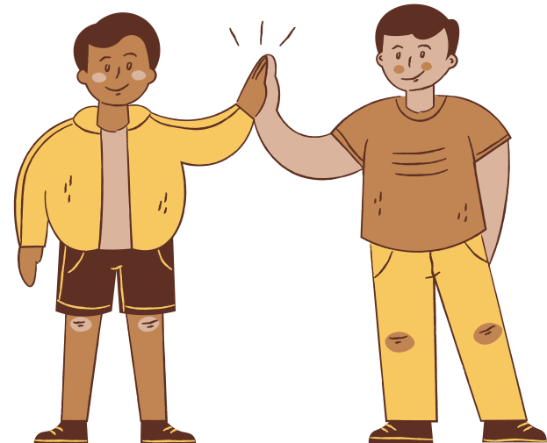

Connect with others.
Rent a specialised person who understands you and connect with you.
Acknowledge your feelings.
Our trained workers will make you feel comfortable and give you a gist of love, care and affection just like a family member

Slide 16
Risk Analysis and potential threats:
Rent up service needs time and lot of work to come in play plus additional security, rules, and regulations with government permit may also be applicable.
Our home therapies like videos, games may not be soothing for everyone as no treatment is 100% applicable.
User data and privacy is at upmost priority for us as it may concern with personal feelings of users.
Our application is only for mild mental issues or to practise mental health not for severe or urgent cases.

Slide 17
Future Plans & deployement:
Our very first goal to deploy the app on real time basis.
By analysing data, to ameliorate our app features more effective and fruitful for large audience.
Building a platform like Twitter where people can share their thoughts without revealing their true identity and share their feelings to lighten their mood.
For rent up service, we need to make the whole action plan and bring that to work practically.

Slide 18




Mentisano
Project Timeline
1
2
3
4
Brainstorming and Idea Generation
Idea Selection
Features in App
Start of Development
5
6
7
End of Development
Testing
Prototype Ready

Slide 19

Thank you!

Slide 20

References:
https://www.canva.com/
https://flutter.dev/
https://pub.dev
https://www.apollo247.com
https://stackoverflow.com/
https://www.unicef.org/mental-health-on-my-mind
https://www.flock.com/ (Communication purpose)
https://www.pexels.com

